Slide 1
Solar power calculator
A Lorenz Miguel A. Gracia presentation
SDF04 - object oriented programming
LFCA311M157

Slide 2
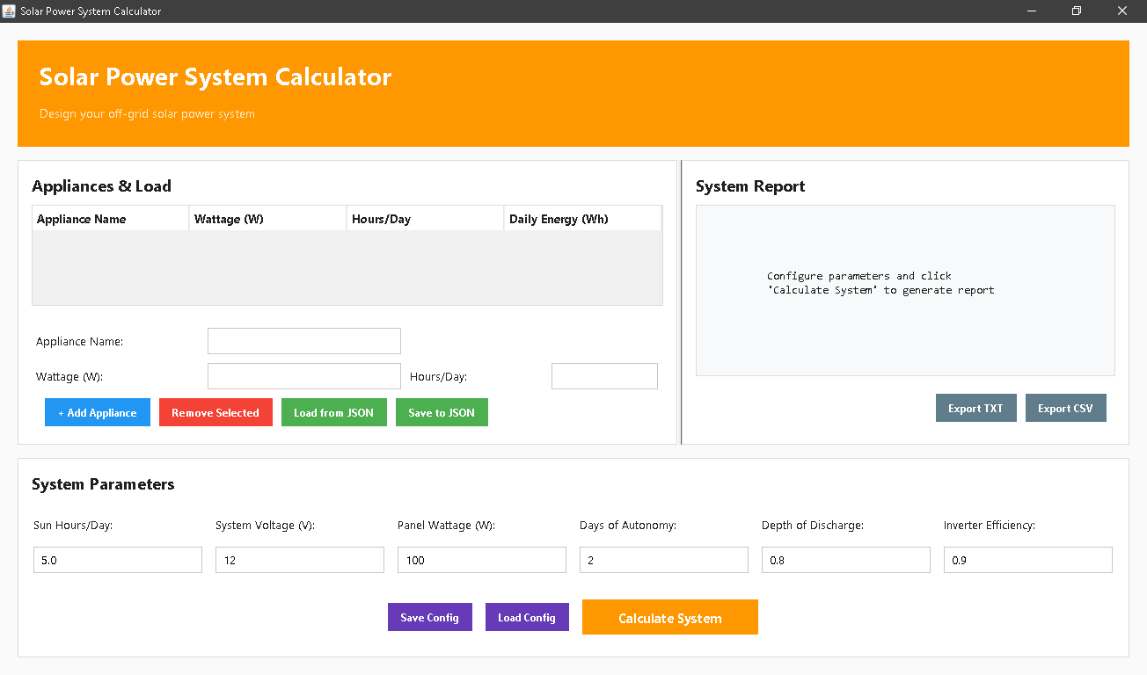
System introduction
Project objectives
Goals:
Input appliance loads
Persist appliance list
Compute panels, batteries, inverter
Provide formatted report

Slide 3
Features Overview
Interactive CLI menu
Load/save appliance lists via JSON
Add appliances (name, wattage, quantity, hours/day)
Enter system parameters (sun hours, voltage, panel rating, days of autonomy, DoD, inverter eff)
Output: total daily load, number of panels, battery capacity (Ah & Wh), inverter size, charge-controller current
Warnings and info messages
Software Overview
The Solar Power System Calculator is a Java-based application designed to help users accurately size off-grid solar energy systems. It allows users to input their household or equipment power requirements, then calculates the necessary solar panels, battery capacity, inverter size, and charge controller ratings. By automating complex energy formulas, the software simplifies solar system design for students, engineers, and installers.

Slide 4
Key formula
Show formulas:
Total Daily Energy (Wh) = Σ (wattage × quantity × hours/day)
Required Solar Power (W) = TotalDailyEnergy ÷ sunHours
NumberOfPanels = ceil(RequiredSolarPower ÷ panelWatt)
BatteryCapacityWh = (TotalDailyEnergy × daysOfAutonomy) ÷ (DoD × inverterEfficiency)
BatteryCapacityAh = BatteryCapacityWh ÷ systemVoltage
InverterSize (W) = TotalDailyEnergy ÷ inverterEfficiency
ChargeControllerCurrent (A) = (panelWatt × numberOfPanels ÷ systemVoltage) × 1.25
Discuss assumptions & safety margin (10-20%)

Slide 5
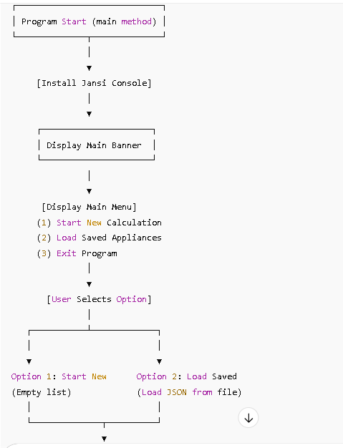
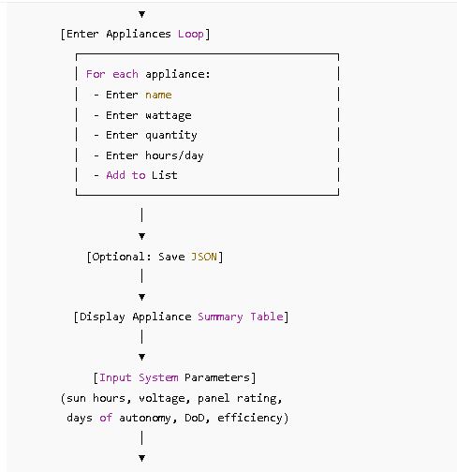
CLI Main flow

Slide 6
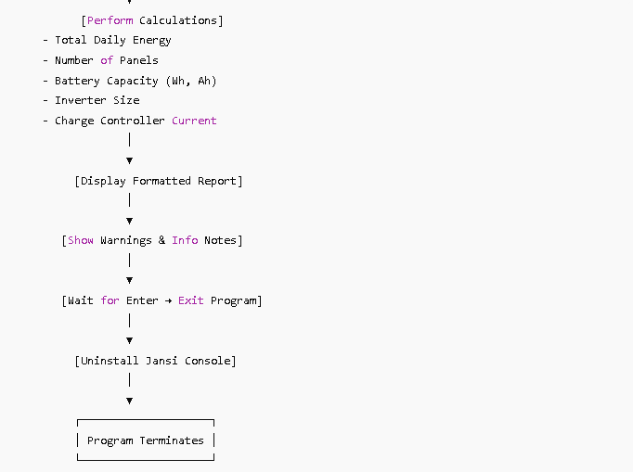

Slide 7
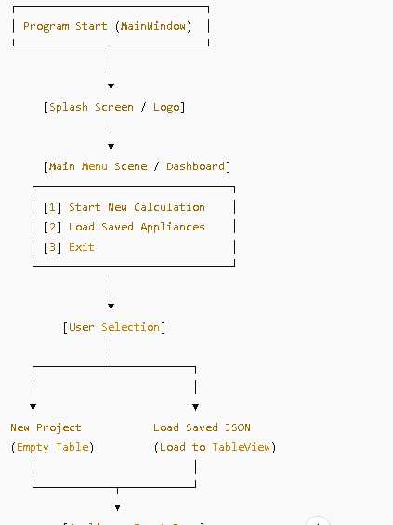
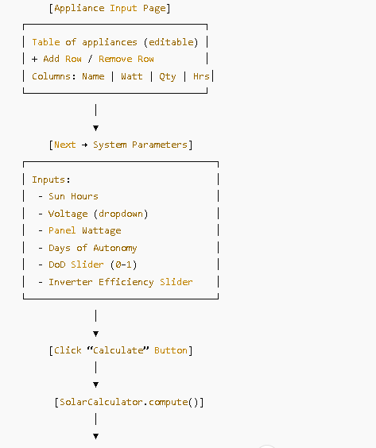
GUI main flow

Slide 8
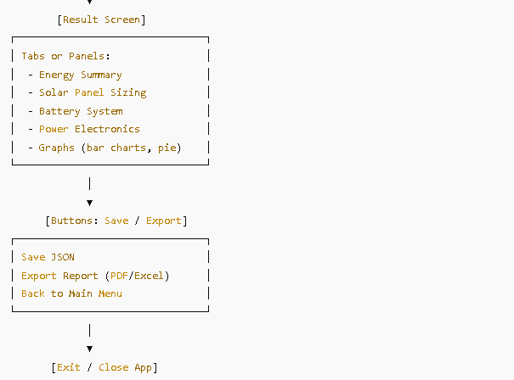

Slide 9
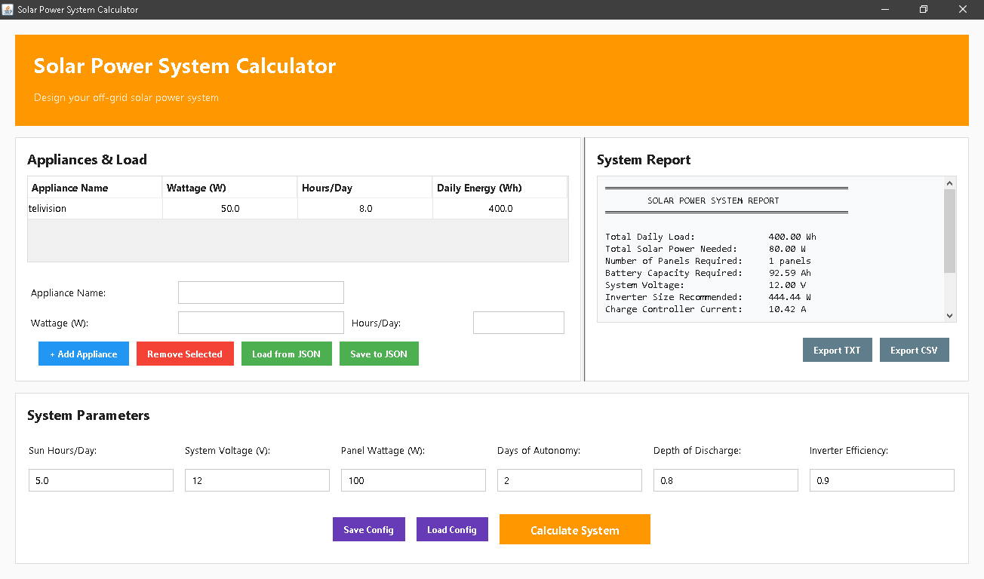
Data input
Data example
Application name: telivision
Wattage: 50
Hours per day: 8

Slide 10
Thank you po, any questions?
Github: https://github.com/lorenz-MotionGraphics/javaSPS.git

